Slide 1
Document Similarity & Applications (i) Resonance Analysis (ii) Crowdsourced Recommendation Systems UGCA October 9, 2018

Slide 2
Grading: Assignment 1
Please write your name inside the document
If I check a box, it means I found some issues with your answer.
Data collection
Preprocessing
Brand lift analysis
Interpretation and advice
Attribute lifts and interpretation
Aspiration analysis

Slide 3
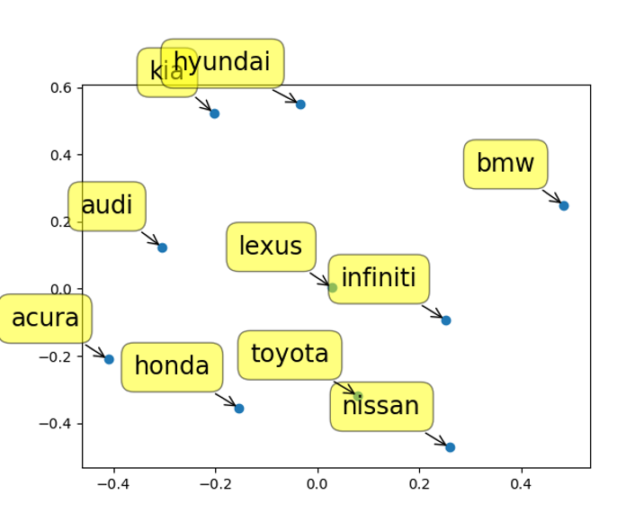
What Can We Say From MDS?
Did not discuss brands (e.g., BMW) that are farthest from all other brands
Did not discuss brands that are most compared to all other brands
Did not discuss any surprises (e.g., Kia and Hyundai showing up in a luxury forum, or Toyota being compared with Nissan rather than Honda)

Slide 4
Grading: Assignment 1
Attribute analysis
Did not discuss how a luxury brand (like BMW) does not have the highest association with the top attributes
Did not discuss the brand which has the highest association with multiple attributes (e.g., Audi)
Aspiration analysis
Love, best, etc. are not indicators of aspiration
Can’t use attributes like luxury or performance as indicators of aspiration
Did not use aspiration words like “dream”, “hope to”, “love to”, “wish to”, “want to” etc.
Did not combine aspiration words into a single word. The problem here is that the frequency of these individual words is low, and hence lift values will be somewhat unreliable. Further, different words may have very different lift values for a given brand.

Slide 5
Assessing Document Similarity
Needed for document clustering/categorization & retrieval
Many business applications (to be discussed)
Start with a numerical representation of each document
Presence absence of each term (0/1)
Raw or scaled frequency of each term
TF-IDF of each term in a document
Given a td-idf (or other) matrix of documents & terms
Two choices to calculate similarity between the documents
Choice 1: Calculate Euclidean distances between documents

Slide 6
Choice 2: Angles Instead of Distances
n-dimensional space with n terms
A document (e.g., tweet) represented
by its coordinates in this term space
t ₂
d ₂
Doc 2
Term 2
d ₁
Doc 1
θ
t ₁
Term 1
t _{n}
Similarity between documents d₁ and d₂ (could also be a set of keywords) is the cosine of the angle Ɵ between them.
Score between 0 and 1.
Source: http://pyevolve.sourceforge.net/wordpress/?p=2497

Slide 7
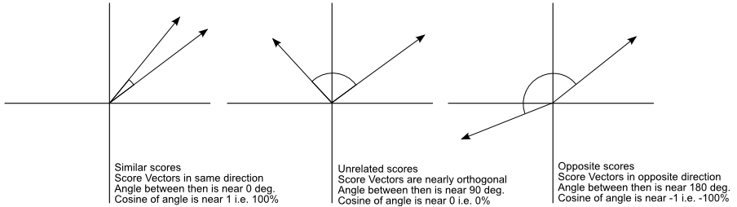
Similar vs. Unrelated Mentions
Ref document
or keywords
Social mention
Is this approach better than Euclidean distances?
Source: http://pyevolve.sourceforge.net/wordpress/?p=2497

Slide 8
Application 1: Assessing Relevance and Resonance
How do we know if our campaign/message is having an impact on what people are talking about?
E.g., political campaign
Product or brand campaign
How companies describe themselves vs. how employees feel
A simple approach: How “far” are the social mentions from the message?

Slide 9
Application 2: Crowdsourced Recommendation Systems
Matching products with customer preferences
The case of hotel search
Web sites (e.g., hotels.com, orbitz.com, Tripadvisor.com) show by one criterion
Rating
Stars
Location
Price
But most customers consider multiple attributes
How can we provide a better match with customer preferences?

Slide 10
A Lot Better than a Single Criterion
Obtain user inputs, e.g.,
Romantic, ambience, mid-priced, beachfront
Business, budget, wi-fi, convenience
Crowdsource!
Extract large # conversations about hotels
Now becomes a document retrieval problem
E.g., query: ~Romantic ~ambience ~mid-price ~beachfront
Calculate cosine similarity between query & mentions
Rank mentions by cosine similarity (0-1)
Perform sentiment analysis to find most positive reviews
Make recommendations

Slide 11
Additional Data
Augment text with:
Vicinity: E.g., Microsoft Virtual Earth Interactive SDK (software development kit)
Proximity: “near a beach”, “near downtown”, “near public transportation” with user geotagging & automatic classification of satellite images of areas near each hotel (e.g., geonames.org)
Additional information become extra dimensions for cosine similarity analysis
Overall results: Far superior to those provided by ANY of the major hotel search sites

